Slide 1

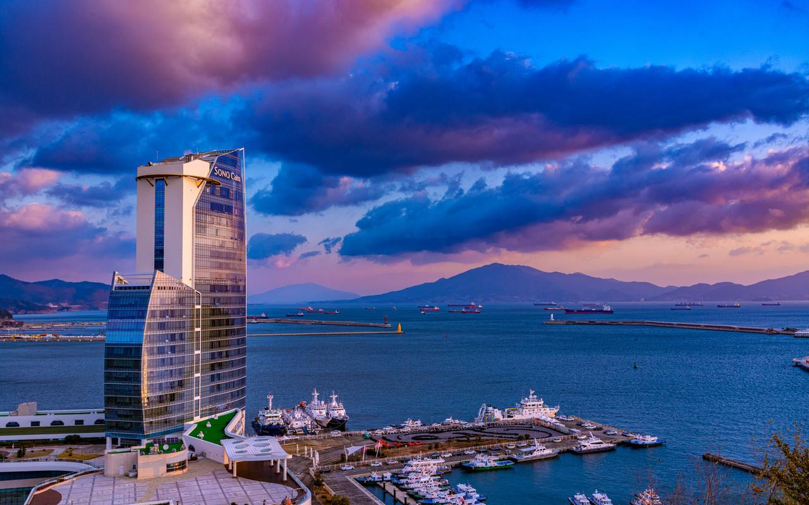
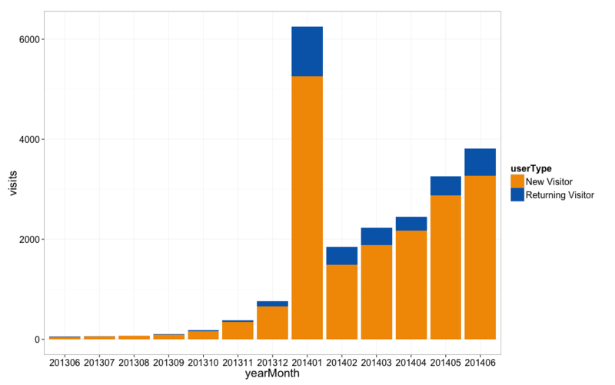
2026 KSEP Annual Meeting
Presenter
Photo
Poster Example for the International Conference of the Korean Society of Exercise Physiology
Gil-Dong Hong¹, Kenta Suzuki² and Emma Harris³*
¹Daehan University, Korea; ²Japan University, Japan; ³Lakers University, USA
INTRODUCTION
RESULTS
· Paper-poster presentations should be printed on one uniform poster sheep with dimensions not exceeding 120 cm X 90 cm (height X width).
· Paper-poster abstract presentations must be consistent with the contents of the prepared abstract: including a purpose, methods, results, and conclusions.
· Paper-poster presentations are 2 minutes in duration with 1 minutes of questions from the audience and responses from presenter
· The font size of the poster should be clearly visible at 3 m
· Paper-poster presentations should be printed on one uniform poster sheep with dimensions not exceeding 120 cm X 90 cm (height X width).
· Paper-poster abstract presentations must be consistent with the contents of the prepared abstract: including a purpose, methods, results, and conclusions.
· Paper-poster presentations are 2 minutes in duration with 1 minutes of questions from the audience and responses from presenter
· The font size of the poster should be clearly visible at 3 m
Sample
METHODS
· Paper-poster presentations should be printed on one uniform poster sheep with dimensions not exceeding 120 cm X 90 cm (height X width).
· Paper-poster abstract presentations must be consistent with the contents of the prepared abstract: including a purpose, methods, results, and conclusions.
· Paper-poster presentations are 2 minutes in duration with 1 minutes of questions from the audience and responses from presenter
· The font size of the poster should be clearly visible at 3 m
CONCLUSION
· Paper-poster presentations should be printed on one uniform poster sheep with dimensions not exceeding 120 cm X 90 cm (height X width).
· Paper-poster abstract presentations must be consistent with the contents of the prepared abstract: including a purpose, methods, results, and conclusions.
· Paper-poster presentations are 2 minutes in duration with 1 minutes of questions from the audience and responses from presenter
· The font size of the poster should be clearly visible at 3 m
*E-mail correspondence: Emma Harris@KSEP.com

